Slide 1
BOOK ‘EM!
START
This Photo is licensed under CC BY-SA

Slide 2
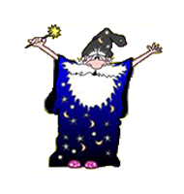
…………………………………………………………………………………………………………………………………………
I’m so glad you’re here!
I have a lot of new books to sort, but I can’t tell what genre they are.
Can you help me figure it out?
Help! I don’t know what “genre” means
Yes, let’s get started!
This Photo is licensed under CC BY-SA

Slide 3
…………………………………………………………………………………………………………………………………………
Oh, let me help you understand it a bit better!
“Genre” is the word we use to describe a type
of book. For example, fantasy, mystery, and horror are types of genres.
Let’s practice to see if we understand it better now.
Yes, let’s get started!
This Photo is licensed under CC BY-SA

Slide 4
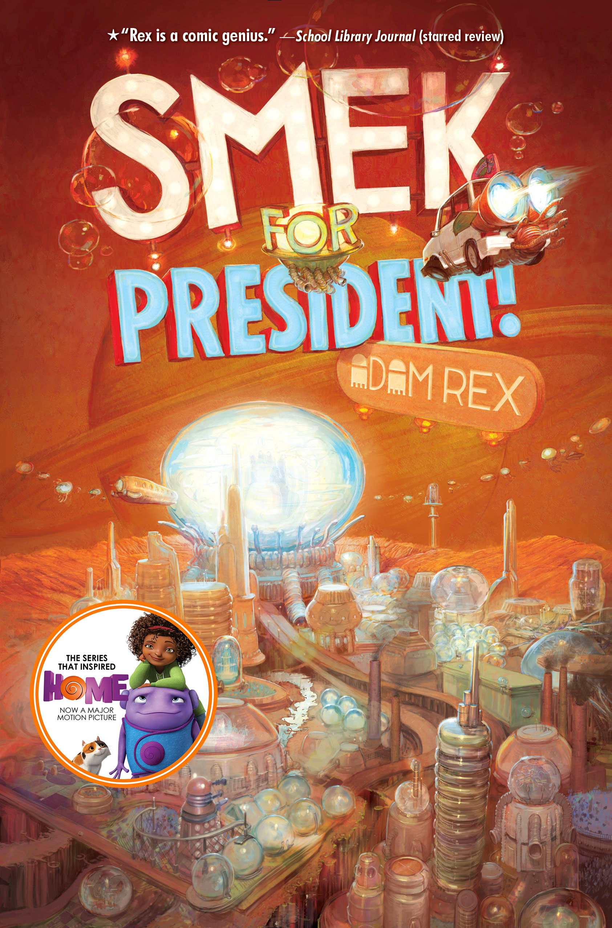
Tip and J.Lo are back for another hilarious intergalactic adventure. And this time (and last time, and maybe next time), they want to make things right with the Boov. After Tip and J.Lo banished the Gorg from Earth in a scheme involving the cloning of many, many cats, the pair is notorious—but not for their heroics. Instead, human Dan Landry has taken credit for conquering the Gorg, and the Boov blame J.Lo for ruining their colonization of the planet.
Science Fiction
Realistic Fiction
Fantasy

Slide 5
That’s a really good guess because of the supernatural elements, but there is a genre that is a better fit. The book cover and description have lots of clues
to help you figure it out.
Try again!
Re-read the description
Science Fiction
Realistic Fiction
Fantasy

Slide 6
I wish that we had spaceships and aliens flying around, but until NASA gives us different information, those elements are not realistic. Which genre is a better fit for this book?
Try again!
Re-read the description
Science Fiction
Realistic Fiction
Fantasy

Slide 7
You’re right! This book has a lot of supernatural elements that are based on science, and we can see flying cars and futuristic-looking landscapes on the cover as well. Nice work!
Next
Book

Slide 8
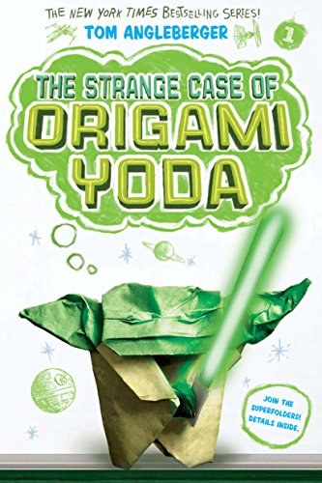
Not so long ago, in a middle school
not so far away, a 6th grader named Dwight folded an origami finger puppet of Yoda. For class oddball Dwight, this wasn't weird. It was typical Dwight behavior. But what is weird is that Origami Yoda is uncannily wise and prescient. He can predict the date of a pop quiz, guess who stole the classroom Shakespeare bust, and save a classmate from embarrassment with some well-timed advice
Realistic
Fiction
Science Fiction
Mystery

Slide 9
That’s a great guess, but it’s not the best fit. While the picture on the cover certainly looks like it could be science fiction, our biggest clue comes from reading the book description.
Try again!
Re-read the description
Realistic
Fiction
Science Fiction
Mystery

Slide 10
That’s a great guess, but it’s not the best fit. While the title sounds like it could be a mystery, our biggest clue is going to come from reading the book description.
Try again!
Re-read the description
Realistic
Fiction
Science Fiction
Mystery

Slide 11
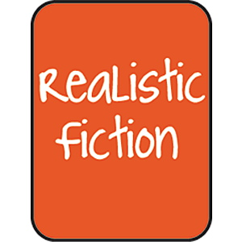
Great job! This is a tricky one because at first glance, the cover looks like it could be a science fiction book and the title sounds like it could be a mystery. In this case, our answer comes from the book description, where we see that the story has a setting, characters, and events that could happen in real life.
Next
Book

Slide 12
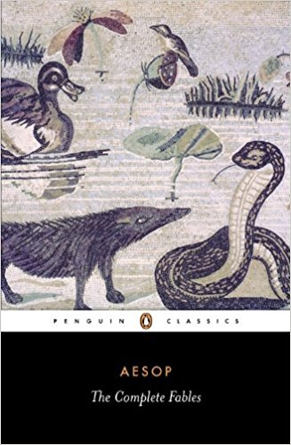
Aesop's Fables is a collection of fables written by a slave and story-teller who lived in Ancient Greece between 620 and 560 BC. Aesop's Fables are mostly short animal stories with each fable ending with a moral advice. His fables are some of the most well known
in the world. Many stories, such as
"The Fox and the Grapes” and
“The Tortoise and the Hare,” are
well-known throughout the world.
Realistic
Fiction
Traditional
Fantasy

Slide 13
I wish that animals could talk, but I don’t think they have that ability. These stories are not realistic—take a look at the description again to see if you can find a better fit!
Try again!
Re-read the description
Realistic
Fiction
Traditional
Fantasy

Slide 14
That’s a good guess, since fantasy books often do have talking animals in them. However, there is a genre that is a better fit. Think about how old these stories are—that’s an important clue!
Try again!
Re-read the description
Realistic
Fiction
Traditional
Fantasy

Slide 15
You’re right! Aesop’s stories have been told orally throughout history, so they are considered traditional literature.
Traditional
Literature
Next
Book

Slide 16
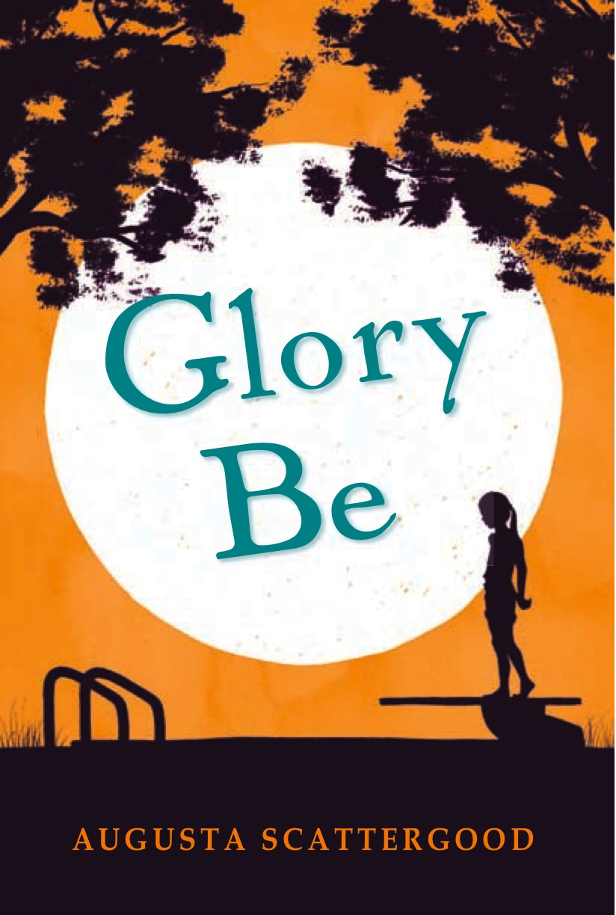
A Mississippi town in 1964 gets
riled when tempers flare at the segregated public pool. As much as Gloriana June Hemphill, or Glory as everyone knows her, wants to turn twelve, there are times when Glory wishes she could turn back the clock a year. Maybe it’s the new girl from the North that’s got everyone out of sorts. Or maybe it’s the debate about whether or not the town should keep the segregated public pool open.
Realistic
Fiction
Historical Fiction
Fantasy

Slide 17
That’s a really good guess since the plot does sound like something that really could have happened, but there is a clue in the description that gives us an even better way to describe the book. Look at the year in which it takes place.
Try again!
Re-read the description
Realistic
Fiction
Historical Fiction
Fantasy

Slide 18
Fantasy books are a lot of fun to read, but this book doesn’t have the right elements to be considered part of the fantasy genre. Read the description
of the plot to see if you can
find which genre is a better fit!
Try again!
Re-read the description
Realistic
Fiction
Historical Fiction
Fantasy

Slide 19
Great work! Because this book is set in the past and has a plot that feels like it could really have happened, it is a work of historical fiction.
Next
Book

Slide 20
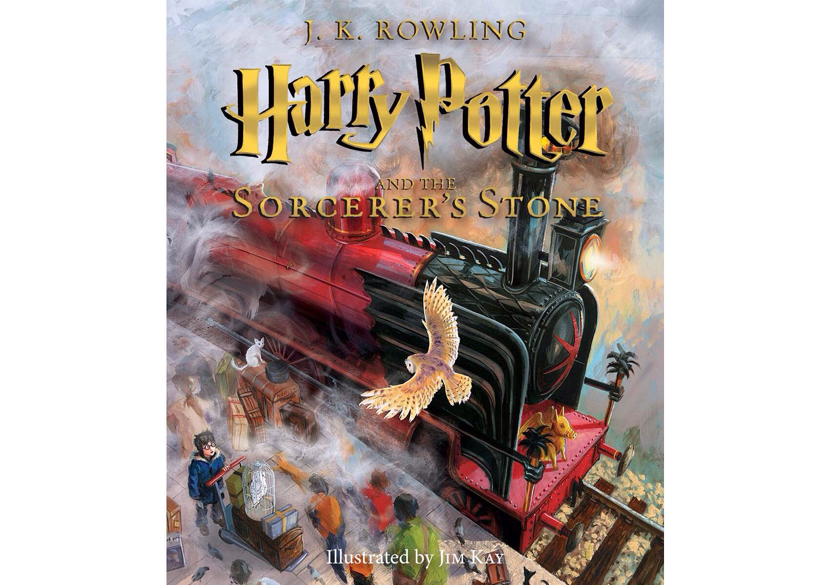
Harry Potter has never even heard of Hogwarts when the letters start dropping on the doormat at number four, Privet Drive. They are swiftly confiscated by his grisly aunt and uncle. Then, on Harry's eleventh birthday, a great beetle-eyed giant of a man called Rubeus Hagrid bursts in with some astonishing news: Harry Potter is a wizard, and he has a place at Hogwarts School of Witchcraft and Wizardry. An incredible adventure is about to begin!
Realistic Fiction
Fantasy
Traditional

Slide 21
While some parts of Harry’s story might feel realistic (especially the beginning, before he finds out about Hogwarts), there is a better choice. Think about the magical elements mentioned in the description.
Try again!
Re-read the description
Realistic Fiction
Fantasy
Traditional

Slide 22
Good try, but there’s a genre
that fits this book better.
Traditional literature often has magical elements, but they are stories that have been passed down through history, like folk tales or fables. Use clues from
the description to try again!
Re-read the description
Realistic Fiction
Fantasy
Traditional

Slide 23
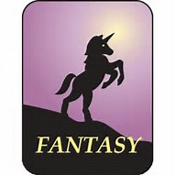
You’re right! The Harry Potter series fall under the fantasy genre because of all of the unrealistic and magical elements.
(They are also Mrs. Crumbley’s favorite books, so check them out if you haven’t read them already!)
Next
Book

Slide 24
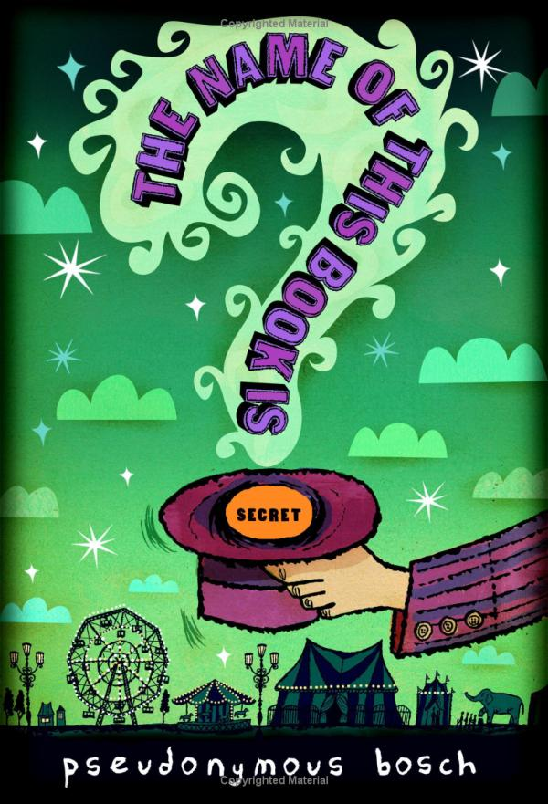
As much as Pseudonymous Bosch would love to sing the praises of his book, he wouldn't want you to hear about his brave heroes. Or about how a mysterious box of vials sends them on the trail of a magician who has vanished under strange (and stinky) circumstances. And he certainly wouldn't want you to know about the hair-raising adventures that follow and the nefarious villains they face. You see, not only is the name of this book secret, the story inside is, too. For it concerns a secret. A Big Secret.
Traditional
Fantasy
Mystery

Slide 25
Traditional literature covers stories, fables, folk tales, and legends that have been passed down through history. This book is modern. Read the description to find clues that can help you pick a better genre.
Try again!
Re-read the description
Traditional
Fantasy
Mystery

Slide 26
This book has a lot of unusual elements in it, but it doesn’t fall into the fantasy category. There is a genre that
is a much better fit. Read the
description and try again!
Re-read the description
Traditional
Fantasy
Mystery

Slide 27
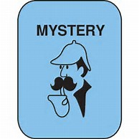
Awesome job!
The book description and the cover gave you the clues to solve the mystery…
of the mystery book!
Finish

Slide 28
Thanks for your help sorting those books! You’re a genre expert now!
Traditional
Literature

